Slide 1
Capstone ETL Process Manager
by Kenneth Copas

Slide 2

Professional Summary
:)
Before Apprenticeship
Software Engineering (JavaScript, HTML, CSS, Java, Python)
Object-Oriented Programming, Dynamic Programming
During Apprenticeship
After Apprenticeship
Courses and Certifications
Data Engineering processes
Database Management, Data Analysis & Visualization
Learned Agile Methodology
Developing skillsets related to Data Engineering (Database Management, Data Processing)
Kenny Copas
Jr. Data Engineer
PeopleShores PBC
Tampa, FL
linkedin.com/in/kennycopas

Slide 3





Tech Stack Overview
Database | Data Processing | Application | Visualization

Slide 4
Project Overview Functional Requirements
ETL Pipeline
- Extract
- Transform
- Load
Command Line Interface
- User-friendly
- Data Querying
Analysis & Visualization
- Tell a Story
- Support Claims

Slide 5
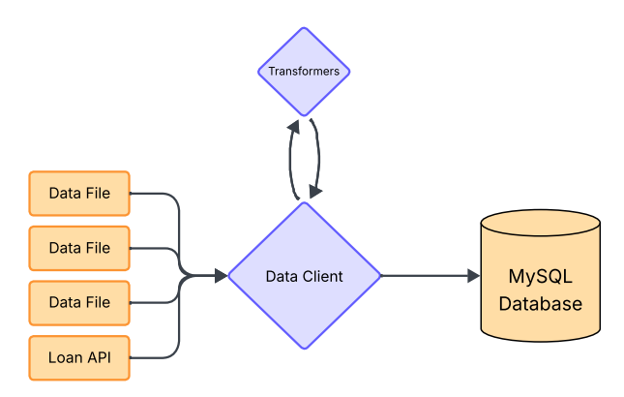
ETL Pipeline
Transform
Data Client
Manages ETL Process
Handles Database Queries
Transformers
Contains file-specific transformer functions
Handles transformer mapping
Extract
Load

Slide 6
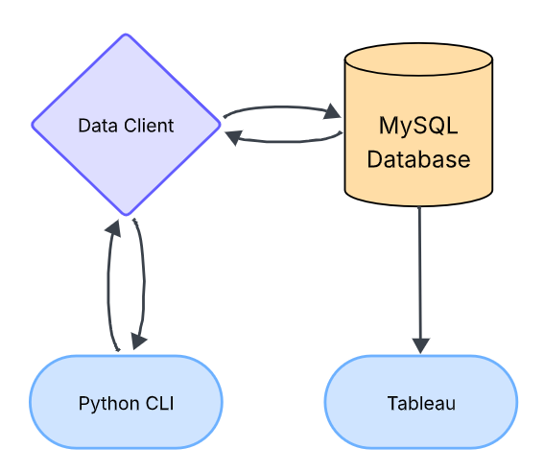
CLI & Tableau
Query
Data Client
Cleans and loads data into MySQL for querying
Handles database query requests from CLI
Python CLI
User-friendly database interaction
Sends database queries to Data Client
Tableau
Data Analysis & Visualization
Sources data from MySQL database
Data
Request
Response

Slide 7
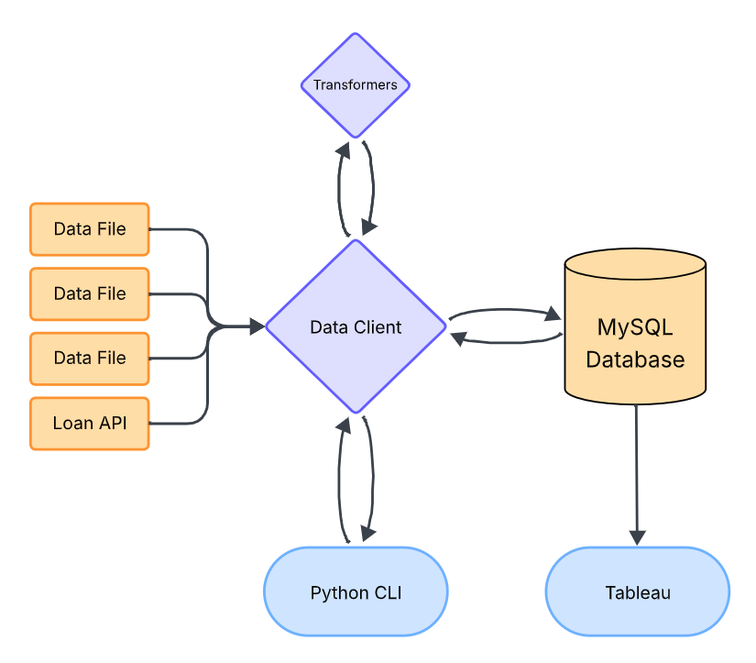
Application Workflow
Central Component
Data Client
Database
MySQL
Frontend
Python CLI & Tableau

Slide 8
Development Process
Data Migration Setup
Data Client
Command Line Interface
Application

Slide 9
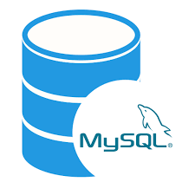
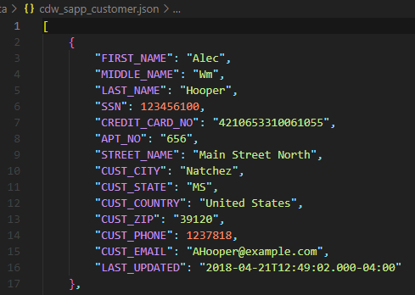
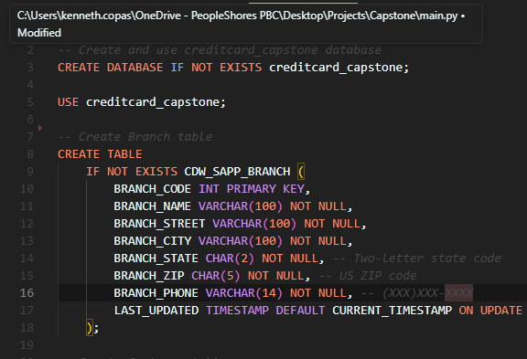
Data Migration Setup
MySQL - Database
cdw_sapp_customer.json - Data
init.sql - Script
MySQL – Database?
Unformatted
Unsorted
Cannot be loaded into database
Initializes Database
Creates Tables
Specifies Schema

Slide 10
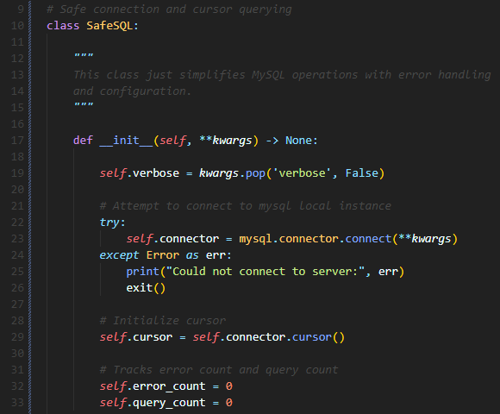
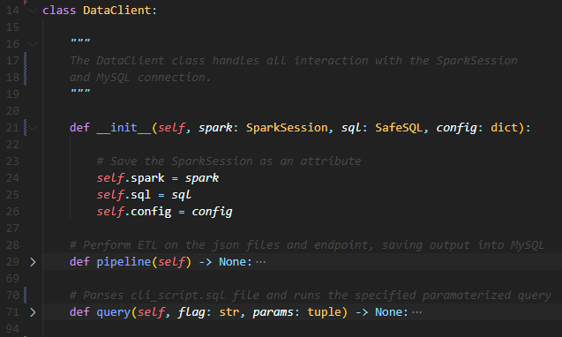
Data Client
sql.py - Utility
data_client.py - Component
General-Purpose
Database Interaction
Error Handling
Application-Specific
Manages ETL Process
Utilizes MySQL and PySpark connections

Slide 11
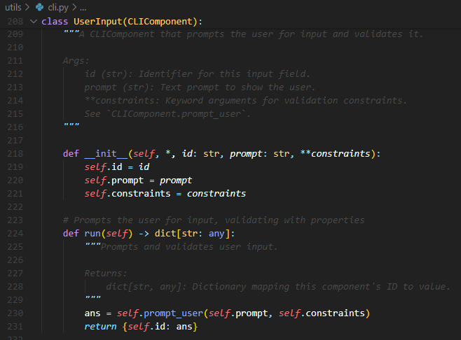
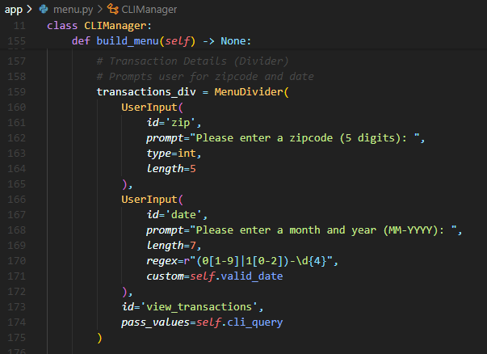
Command Line Interface
cli.py - Utility
menu.py - Component
General-Purpose
CLI Tool-Box
Simple
Application-Specific
User-friendly
Intuitive

Slide 12
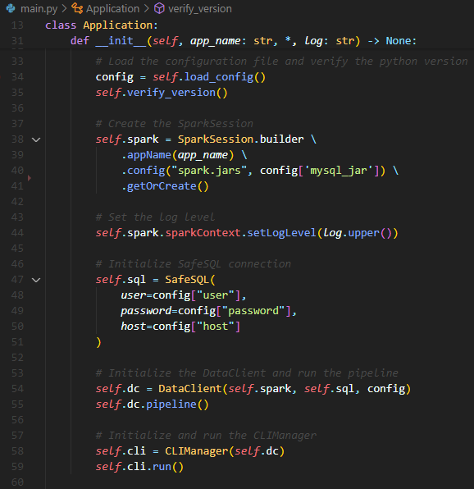
Application
Manager
main.py - Application
Loads Configurations
Initializes and Configures SparkSession (Connection to PySpark)
Creates SafeSQL Connection (Database Connector Utility)
Instantiates Data Client and runs ETL Pipeline
Instantiates and runs CLIManager

Slide 13
Project Structure
main.py # Application requirements.txt # Required Libraries app/ ├── data_client.py # Data Client ├── menu.py # CLI Menu Class └── transformers.py # Transformer Functions config/ ├── config.json # PySpark, MySQL Config └── constants.py # Global Constants data/ # JSON files ├── cdw_sapp_branch.json ├── cdw_sapp_credit_card.json └── cdw_sapp_customer.json | lib/ # MySQL Connector JDBC └── mysql-connector-j-9.3.0.jar sql/ # SQL Scripts ├── cli_script.sql └── init.sql utils/ ├── cli.py # CLI Builder Class └── sql.py # MySQL Connector Class docs/ ├── CAP350_Project_Specs.pdf ├── diagrams/ # Workflow Diagrams └── mapping/ # Mapping PDFs

Slide 14
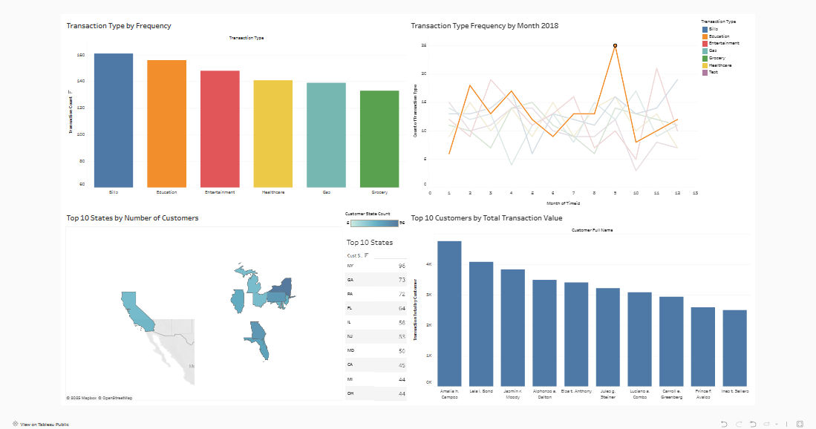
Tableau Visualization

Slide 15
Thanks!

Slide 16
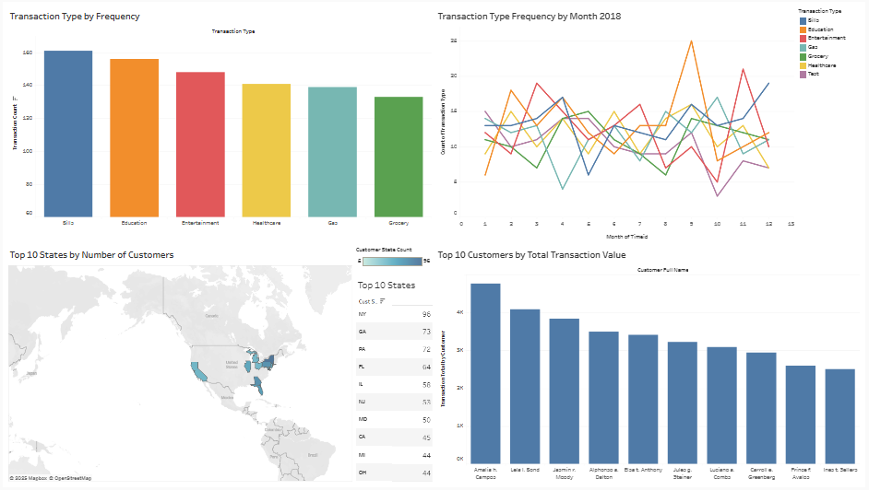
Tableau Visualization

